Slide 1
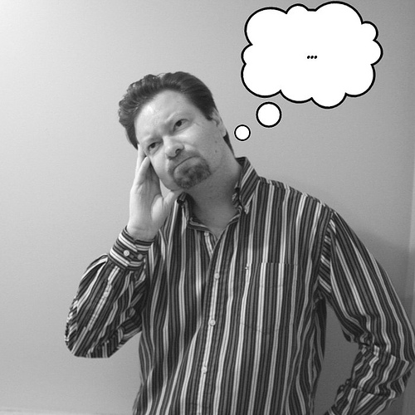
The mind try to remember!
Basic 6 - Unit 6 – Lesson A

Slide 2
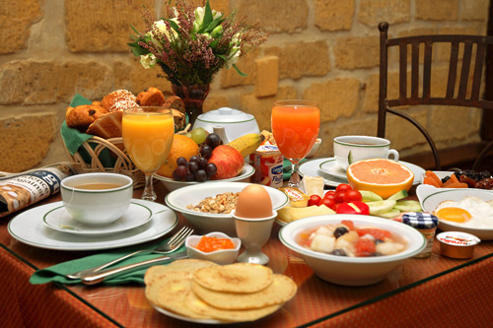

Slide 3
What do you remember about the picture? Tell your partner. Remember to be specific and elaborate ☺

Slide 4
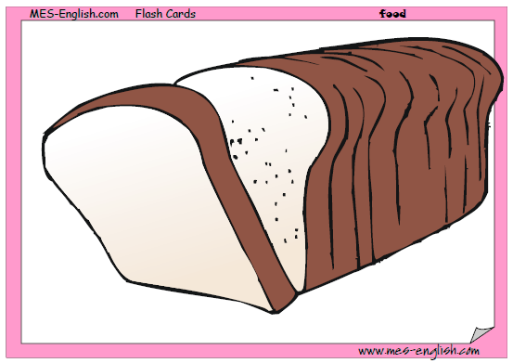
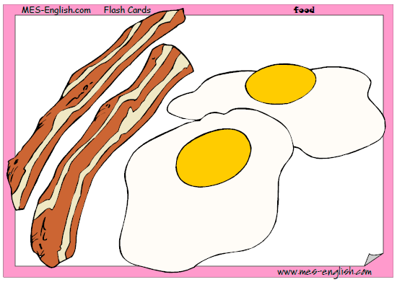

Slide 5
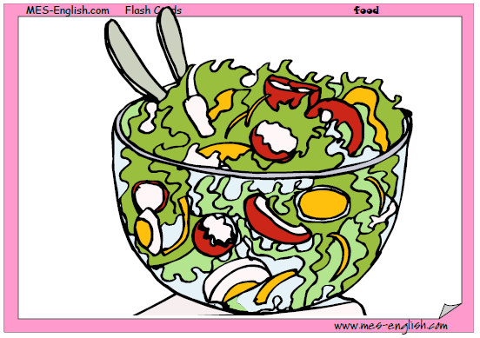
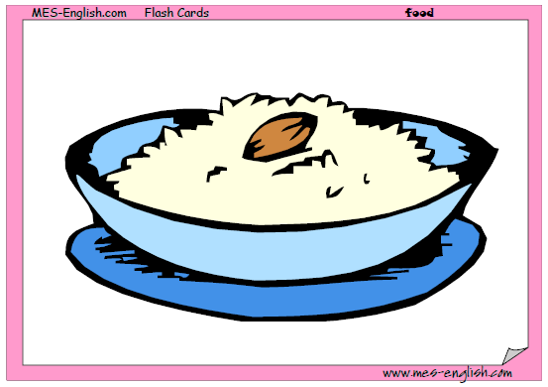


Slide 6


Slide 9
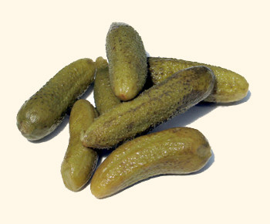
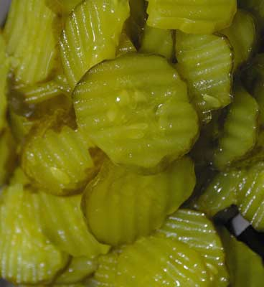

Slide 10


Slide 11
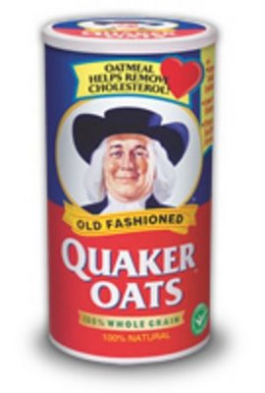
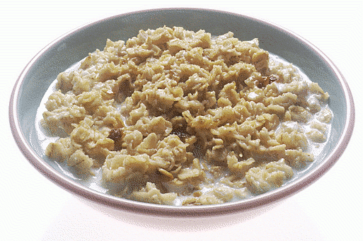

Slide 12
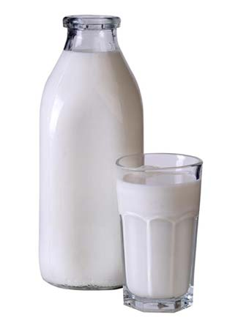
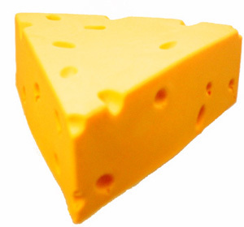
Milk
Cheese

Slide 13

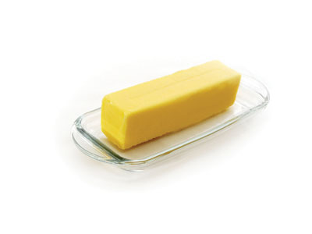
Butter

Slide 14
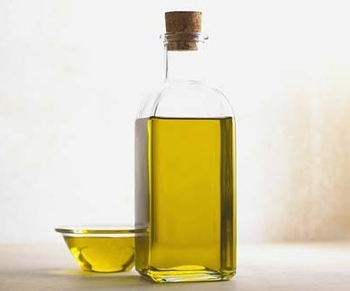
Oil

Slide 17
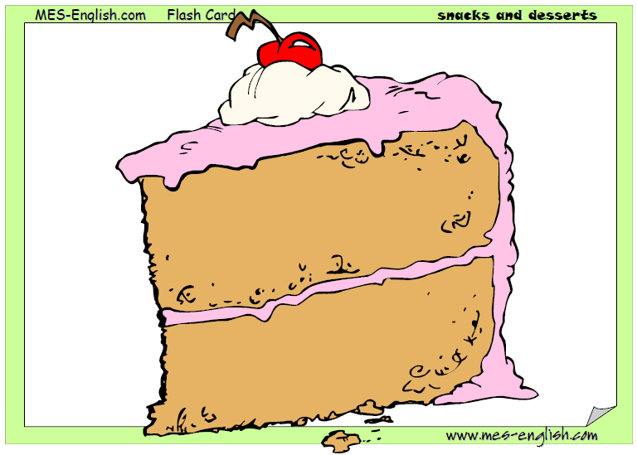
Cake

Slide 18
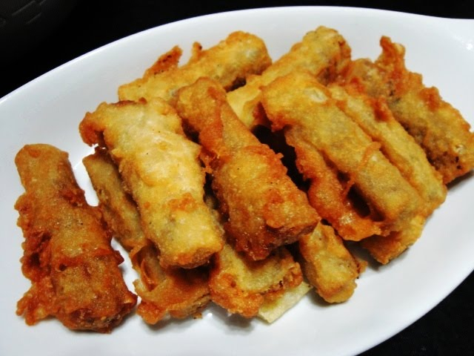


Slide 19
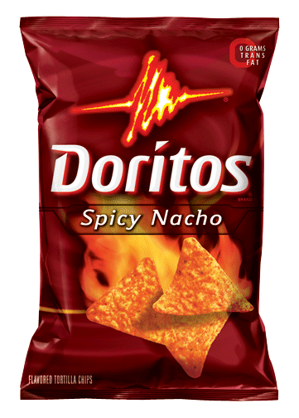


Slide 21
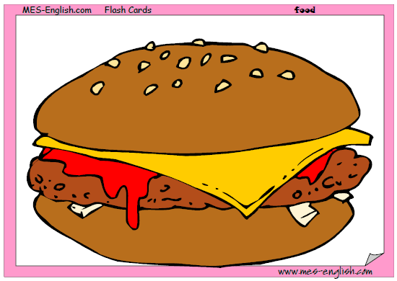
Hamburger

Slide 22
Cereal

Slide 24
Ask your partner
Do you sometimes forget to do your homework?
Do you forget your cell phone?
Do you forget names easily?
Do you need to write things because you have a bad memory?
Are you good at remembering words to songs?
Can you remember all the details when you look at a picture?
Do you sometimes forget your parent´s birthdays?

